Slide 1
Contract Modification and Amendments
Florida Association of Charter School Authorizers
Dr. Kia Scott
Orange County

Slide 2
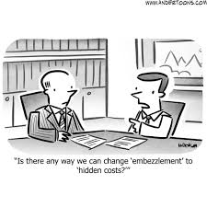
WHEN should you amend or modify a charter school contract?
A charter contract may be modified when there are substantial changes to the original charter contract and/ or charter application.

Slide 3
Reasons why a Charter Contract is modified (OCPS):
Change of address
Change in capacity/ enrollment / or grade configuration
Consolidation /Separation of schools
Change in school’s mission
Accountability

Slide 4
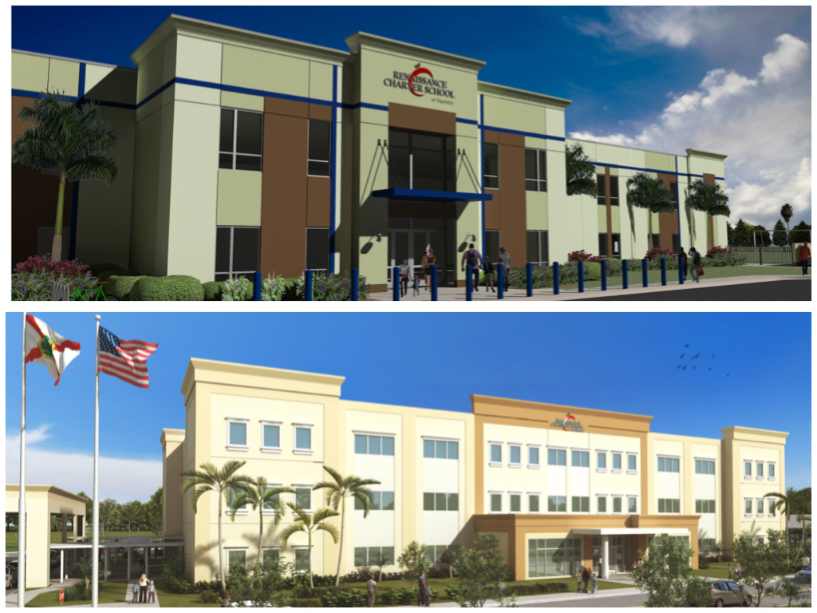
Change of address:
OCPS amends contracts if the address of the school is listed in the contract.
WHY we amend for a location change:
A new location may effect population
May be a change of OCPS Board Member district

Slide 5
Change in capacity/ enrollment / or grade configuration
OCPS amends charter contracts to change the allowable number of students identified in the application and/or contract. A change in grade levels is also brought to the Orange County School Board (OCSB) for action.
WHY we amend for capacity/enrollment/grade configuration:
Statutory provisions
Best interest of the school

Slide 6
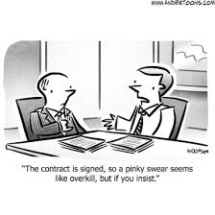
School Consolidation or Separation
OCPS Amends charter contracts for schools that have more than one location or would like to add an additional location with a different MSID number.
WHY we amend for consolidation/separation (examples)
Nap Ford/ Legends
UCP TLA (Middle / High)
Pinecrest Collegiate

Slide 7
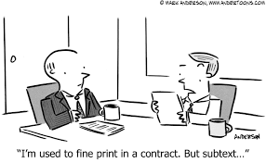
Change in a school’s Mission
OCPS amends charter school contracts when a governing board wants to change the school’s mission statement to match the population.
WHY we amend for a change in mission:
To change to an alternative distinction (Aspire)
To meet the needs of a population to be inclusive (UCP)

Slide 8
School Accountability
OCPS will amend a charter contract if the school’s accountability choice resides within their contract or was stated in the application and a change is desired and justified.
WHY we amend for school accountability.
To change to an alternative distinction (SIR)
- positive example
- negative example

Slide 9
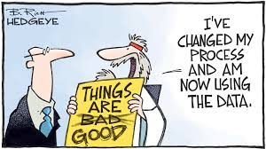
OCPS process for amendments
Written request from the school’s governing board
Research the nature and viability of the request
Review of request by Associate General Counsel
Resolution placed on Board Docs
Meet individually with board members (only if potential problem exists)
Board Vote / Signatures

Slide 10
Questions/Comments/Concerns
Sonic’s buddy Hugo

