Slide 1
Legislative Updates Florida Association of Charter School Authorizers February 21, 2020 Dr. Cinzia De Lange & Dr. Nicki Brisson

Slide 2
CS/HB 23 – Panic Alarms in Public Schools
The bill creates “Alyssa Law.” Requires each public school campus, including charter schools, to be equipped with at least one panic alarm for us in a school security emergency such as an active shooter situation, a non-fire evacuation, or a lockdown. The panic alarm is required to bypass the E911 system so that the emergency signal will be transmitted directly to the local law enforcement agencies designated as first responders to the school. The bill requires panic alarms to be operable at the beginning of the 2021-2022 school year.

Slide 3
HB 91 – Holocaust Education in Public Schools
Requiring charter school instructional personnel to teach specified topics. SB 1660, SB 1628, SB 184, HB 1213 are related bills.

Slide 4
HB 953/SB 1578- Education
Authorizing district school boards and charter school governing boards to allow a specified number of mental health days as excused absences for students.

Slide 5
HB 883/SB 534
Requires DOE to maintain a disqualification list of certain individuals. A charter school shall employ or contract with employees who have undergone background screening as provided in s. 1012.32. An individual may not be employed as an employee or contract personnel of a charter school or serve as a member of a charter school governing board if the individual is on the disqualification list maintained by the department pursuant to s. 1001.10(4)(b). Before making an offer of employment, the charter school must check the database under s.1012.21 and if the individual is in the database, the charter must document the individual’s suitability for employment at the school.

Slide 6
HB 953/SB 1578 - Education
Amends s. 1002.33.
Authorizes state universities and Florida College System institutions to sponsor charter schools;
revises reporting and accountability requirements; provides for funding;
authorizes career and professional academy to be offered by charter school.

Slide 7
HB 953/SB 1578 – Education, cont.
Specifically:
The board of trustees of a sponsoring state university or Florida College System institution under paragraph (a) is the local educational agency for all charter schools it sponsors for purposes or receiving federal funds and accepts full responsibility of all local educational agency requirements

Slide 8
HB 953/SB 1578 – Education, cont.
Specifically:
C) Sponsor accountability. –
1. The department shall, in collaboration with charter school sponsors and charter school operators, develop a sponsor evaluation framework that must address, at a minimum:

Slide 9
HB 953/SB 1578 – Education, cont.
Specifically:
a. The sponsor’s strategic vision for charter school authorizing and the sponsor’s progress toward that vision.
b. The alignment of the sponsor’s policies and practices to best practices for charter school authorizing.
c. The academic and financial performance of all operating charter schools overseen by the sponsor.
d. The status of charter schools authorized by the sponsor, including approved, operating, and closed schools.

Slide 10
HB 953/ SB 1578 – Charter Schools
The proposed language also replaces district school board language with SPONSOR

Slide 11
HB 1083/SB 1062 – Mental Health Procedures
Revises certain notifications relating to involuntary examination of student who is removed from school, school transportation, or school-sponsored activity (pertains to charter schools as well). (9) is specific to charter school requirements with a few additions to the language, i.e. The charter school principal or the principal’s designee shall immediately notify the parent, guardian, or caregiver of a student before the student is removed…

Slide 12
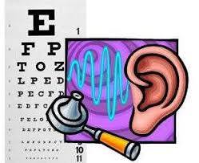
HB 1411/SB 1438– Dyslexia
Requires public schools (1001.2151) to screen all students in kindergarten through grade 3 for dyslexia within a certain timeframe; requires public school students with substantial deficiency in reading to be placed in an intensive remedial intervention program; requires public schools to have at least one person on staff trained in the instruction of students with dyslexia; creates the Dyslexia Task Force within the Department of Education, etc.

Slide 13
CS/SB 534 - Education
Requires the DOE to maintain a disqualification list that includes the identities of certain persons; requires district school boards to investigate certain complaints and report certain results of such investigation to the department; prohibiting an individual who is on the disqualification list from being employed by a charter school or serving as a member of a charter school governing board;

Slide 14
CS/SB 536 – Charter Schools
Establishes the High-Performing Charter School Council; provides the process for approving or denying a charter school application submitted to the council; authorizes charter school sponsors and applicants to provide input to the state board regarding the council’s recommendation; provides grounds on which the council may recommend denial of an application submitted by a high-performing charter school or system.

Slide 15
SB 1400– Education
Creates the minimum base annual salary allocation to assist school districts in providing minimum base annual salaries to classroom teachers; creates the Rewarding Great Classroom Teachers and Principal Program – financial awards go to classroom teachers in public schools who improve students success, as demonstrated by an increase in the percentage of points earned by such schools; etc. Some of the pertinent language from the bill: Beginning on July 1, 2020, each district school board and charter school governing board shall adopt a minimum base annual salary of $47,500 for full time public school classroom teachers…

Slide 16
SB 1420?HB 1029 – Charter Schools
Prohibits sponsors from refusing to receive a charter school application submitted during the calendar year; requires certain charter school employees or governing board members to inform a school district if he or she has completed a criminal history check in another district with a certain timeframe; specifies how many applications a high-performing charter school may submit in any school district in the state to establish and operate a new charter school; revises the virtual instruction a charter school may provide, etc.

Slide 17
SB 1498 – School Turnaround
Revises criteria for schools that are deemed to be in need of intervention and support; provides that a school district may request to change a turnaround option after the first year of implementation; etc. DOES NOT CHANGE LANGUAGE PERTAINING TO CHARTER SCHOOL REQUIREMENTS

Slide 18
SB 2502 – Implementing the 2020-2021 General Appropriations Act
This is a very comprehensive Act that implements the 20-21 General Appropriation Act. Some items that are specific to charter schools are: Specifies the source of charter school capital outlay funding Provides that charter schools are ineligible to receive capital outlay funding unless the governing board chair and school’s chief administrative officer provides an annual certification under oath

Slide 19
SB 7040 – Implementation of the Recommendations of the Marjory Stoneman Douglas HS Safety Commission
Recommendations include: Clarification that the SSO has the power to make arrests on property owned or leased by the charter school; requiring that SSOs must complete mental health crisis intervention training similar to the training required of an SRO;

Slide 20
SB 7040 – Implementation of the Recommendations of the Marjory Stoneman Douglas HS Safety Commission, cont.
Recommendations include: the clarification that school principals must ensure that incidents concerning school safety and discipline are reported to the DOE through the SESIR system – charter school governing board must withhold the salary of a charter school administrator for failure to comply with such requirements; charter school governing boards must adopt an emergency even family reunification plan for the purpose of reuniting students and employees with their families in the event of a mass casualty or emergency situation;

Slide 21
SB 7040 – Implementation of the Recommendations of the Marjory Stoneman Douglas HS Safety Commission, cont.
Recommendations include: clarifies that the law enforcement presence on a threat assessment team must include a sworn law enforcement officer who has undergone threat assessment training identified by the OSS. All members of the TAT must be involved in the process from start to finish, including the final disposition decision. Clarifying that a school security guard serving in the capacity of an SSO is considered to be a “noninstructional contractor” for the purpose of background screening, which must be satisfied prior to the school security guard being permitted access to school grounds;

Slide 22
SB 7040 – Implementation of the Recommendations of the Marjory Stoneman Douglas HS Safety Commission, cont.
Recommendations include: that the sheriff’s office must review and approve the results of the psychological evaluation and drug tests for each applicant seeing Feis guardian program certification, before accepting the applicant into the Feis guardian program. Adds requirements to the Mental Health Plan.

Slide 23
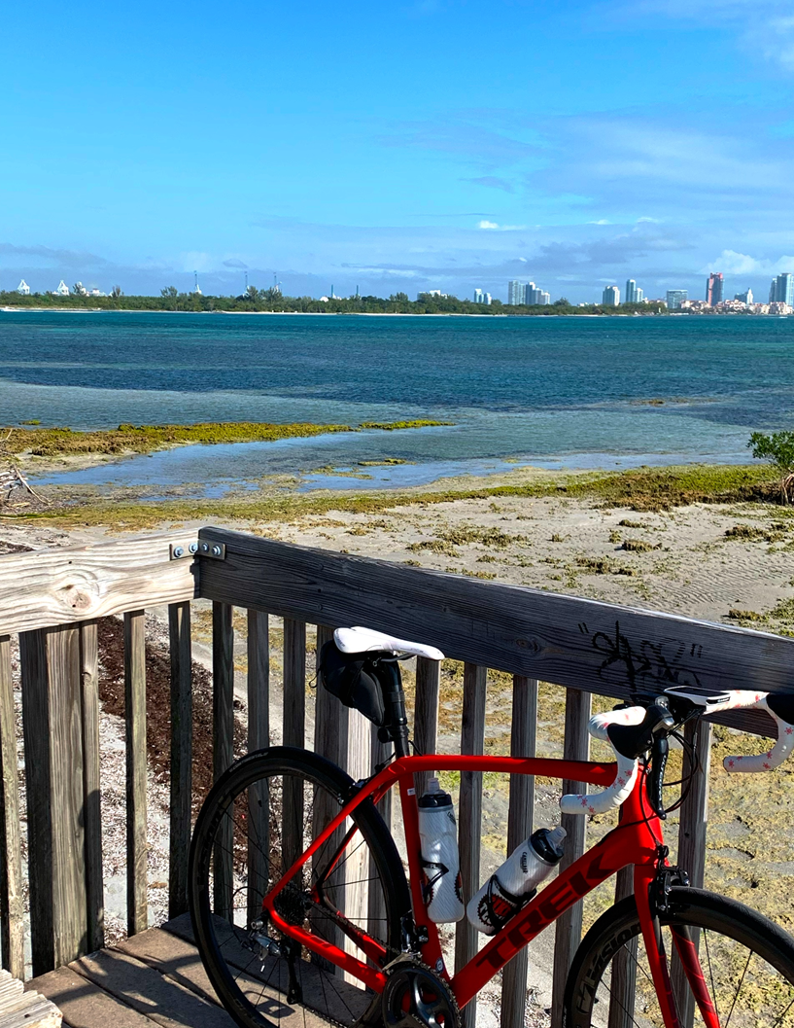
Thanks!
“Nothing compares to the simple pleasure of riding a bike.”
John F. Kennedy
You can find me at:
nbrisson@dadeschools.net
305-995-1530

