Slide 1
Welcome
January 15, 2021

Slide 2
Agenda
9:00 AM - 9: 15 AM President's Welcome / Ice Breaker (Poll)
9:15 AM - 9:20 AM Treasurer's Report
9:20 AM - 9: 35 AM Annual Report (Yolanda Miranda-Hill, DOE)
9:35 AM - 10:00 AM COVID Conversations/Hair on Fire Issues
10:00 AM - 11:00 AM Annual Report/Rubric Workshop

Slide 3
Ice Breaker
Poll

Slide 4
Treasurer’s Report Vanessa Glenn

Slide 5
DOE Annual Report Tool
Presenter: Yolanda Miranda-hill

Slide 6
COVID Conversations (Hair on Fire)
Full Group discussion (25 minutes)

Slide 7
Annual Report Workshop
Facilitators: Melissa brady, Valerie hyer, gina Koch, and mahati tonk

Slide 8
Workshop Purpose
To review and provide feedback on 3 different Annual Report templates in order to create a general template for all Florida authorizers to further customize.
Endgame: Publish to FACSA website as a model tool template.

Slide 9
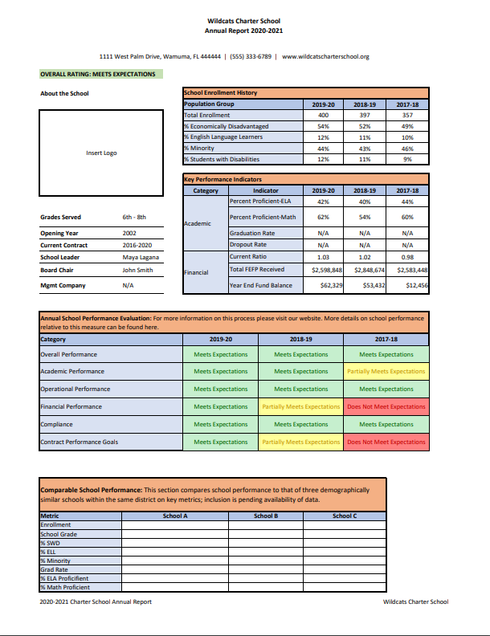
HOW WE GOT HERE
Dr. Valerie Hyer

Slide 10
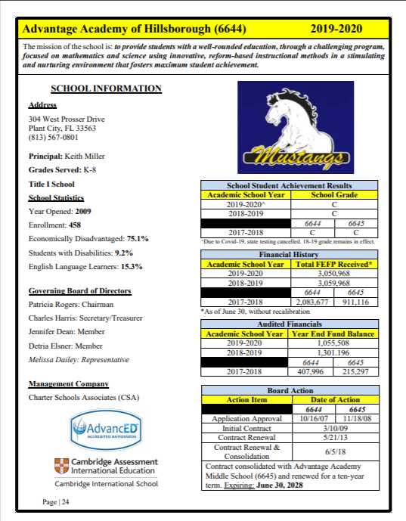
HOW WE GOT HERE
Amy Fordyce

Slide 11
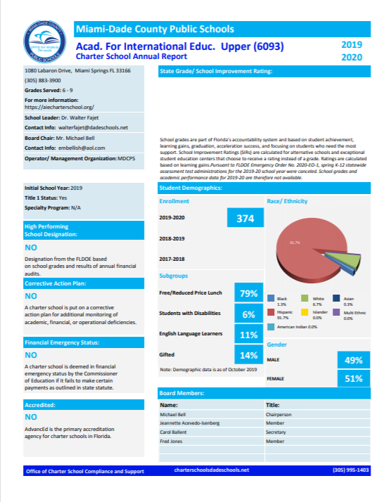
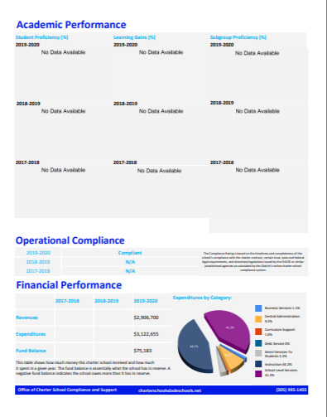
HOW WE GOT HERE
Mahati Tonk and Gina Koch

Slide 12
Break Out Rooms (30 Minutes)
Process
3 rooms, 3 tools - 10 minutes in each room
Use the chat to record to your responses even if you’ve discussed them with the group.
Facilitators will rotate every ten minutes to meet with the next group.
Norms
Stay focused on the GOAL which is to distinguish what components of each tool we would keep or toss.

Slide 13
Survey (5 Minutes)
Complete the survey and then rejoin us here for a final discussion.
This link can be found in the chat: https://www.surveymonkey.com/r/CZDC577

