Slide 1
Charter Renewal-Evaluation of Indicators
2021

Slide 2
Introduction
The District School Board of Pasco County is committed to the sponsorship of charter schools that demonstrate academic success, fiscal accountability and sound governance. This document outlines the requirements for the charter renewal process. The completion of the charter renewal packet should provide clear and compelling evidence of the school’s performance and success, based on credible information and data, to support its renewal. The charter school will be expected to provide both narrative responses and data that address student achievement, organizational viability and faithfulness of the school’s program and operation to the term of its charter. The inclusion of the school’s strengths, as well as its weaknesses, is essential.

Slide 3
Introduction Continued
The charter school will be required to respond to the following key questions:
Is the charter school’s academic program a success?
Is the charter school fiscally accountable and responsible?
Is the charter school a viable organization?
Has the charter school been faithful to the terms of its charter?

Slide 4
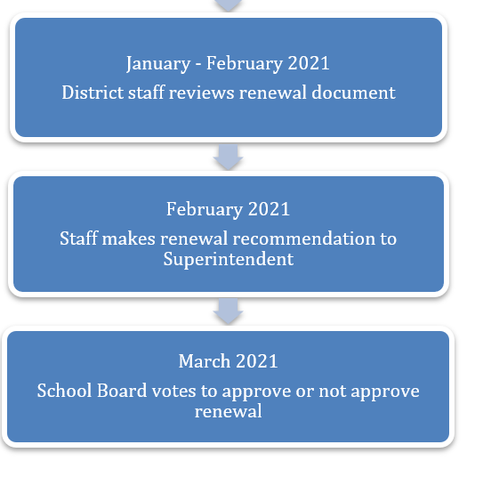
Timeline of Events

Slide 5
Timeline of Events

Slide 6
Renewal Site Visit Checklist [Completed by Program Coordinator for Charter schools]

Slide 7
Renewal Site Visit Checklist [Completed by pasco county schools renewal team] Marzano

Slide 8
BOARD OF DIRECTORS: List by name and office for each of the following years.

Slide 9
School Administration

Slide 10
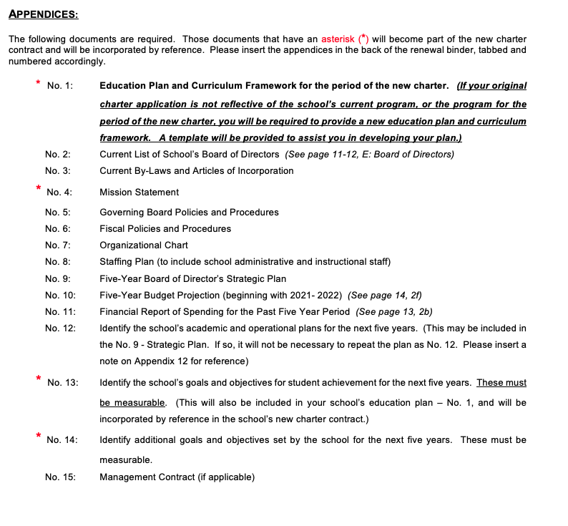
Appendices

Slide 11
Evaluation of Indicators

Slide 12
Evaluation of Indicators Continued

Slide 13
Evaluation of Indicators Continued

Slide 14
Evaluation of Indicators Continued

Slide 15
Evaluation of Indicators Continued

Slide 16
Evaluation of Indicators Continued

Slide 17
Evaluation of Indicators Continued

Slide 18
Evaluation of Indicators Continued

Slide 19
Evaluation of Indicators Continued

Slide 20
Evaluation of Indicators Continued

Slide 21
Evaluation of Indicators Continued

Slide 22
Evaluation of Indicators Continued

Slide 23
Evaluation of Indicators Continued

Slide 24
Evaluation of Indicators Continued

Slide 25
Evaluation of Indicators Continued

Slide 26
Evaluation of Indicators Continued

Slide 27
Evaluation of Indicators Continued

Slide 28
Evaluation of Indicators Continued

Slide 29
Evaluation of Indicators Continued

Slide 30
Evaluation of Indicators Continued

Slide 31
Evaluation of Indicators Continued

Slide 32
Evaluation of Indicators Continued

Slide 33
Evaluation of Indicators Continued

Slide 34
Evaluation of Indicators Continued

Slide 35
Evaluation of Indicators Continued

Slide 36
Evaluation of Indicators -Exhibits

Slide 37
Evaluation of Indicators -Exhibits

Slide 38
Evaluation of Indicators -Exhibits

Slide 39
Evaluation of Indicators -Exhibits

Slide 40
Evaluation of Indicators -Exhibits

Slide 41
Evaluation of Indicators -Exhibits

Slide 42
Evaluation of Indicators -Exhibits

Slide 43
Renewal Charter Contract
The deadline for receipt of all materials is January 29, 2021. The new charter contract may be negotiated concurrently with the renewal process. However, the renewal charter contract will not be finalized and submitted to the Pasco County School Board until the renewal has been approved by the School Board.

Slide 44
Questions and Comments

