Slide 1
Alyssa’s Law
Dr. Valerie Moore Hyer
manatee county school district
Vice president, FACSA
Notes:
A: Assess for risk of suicide or harm.
L: Listen nonjudgmentally.
G: Give reassurance and information
E: Encourage appropriate professional help.
E: Encourage self-help and other support strategies.

Slide 2
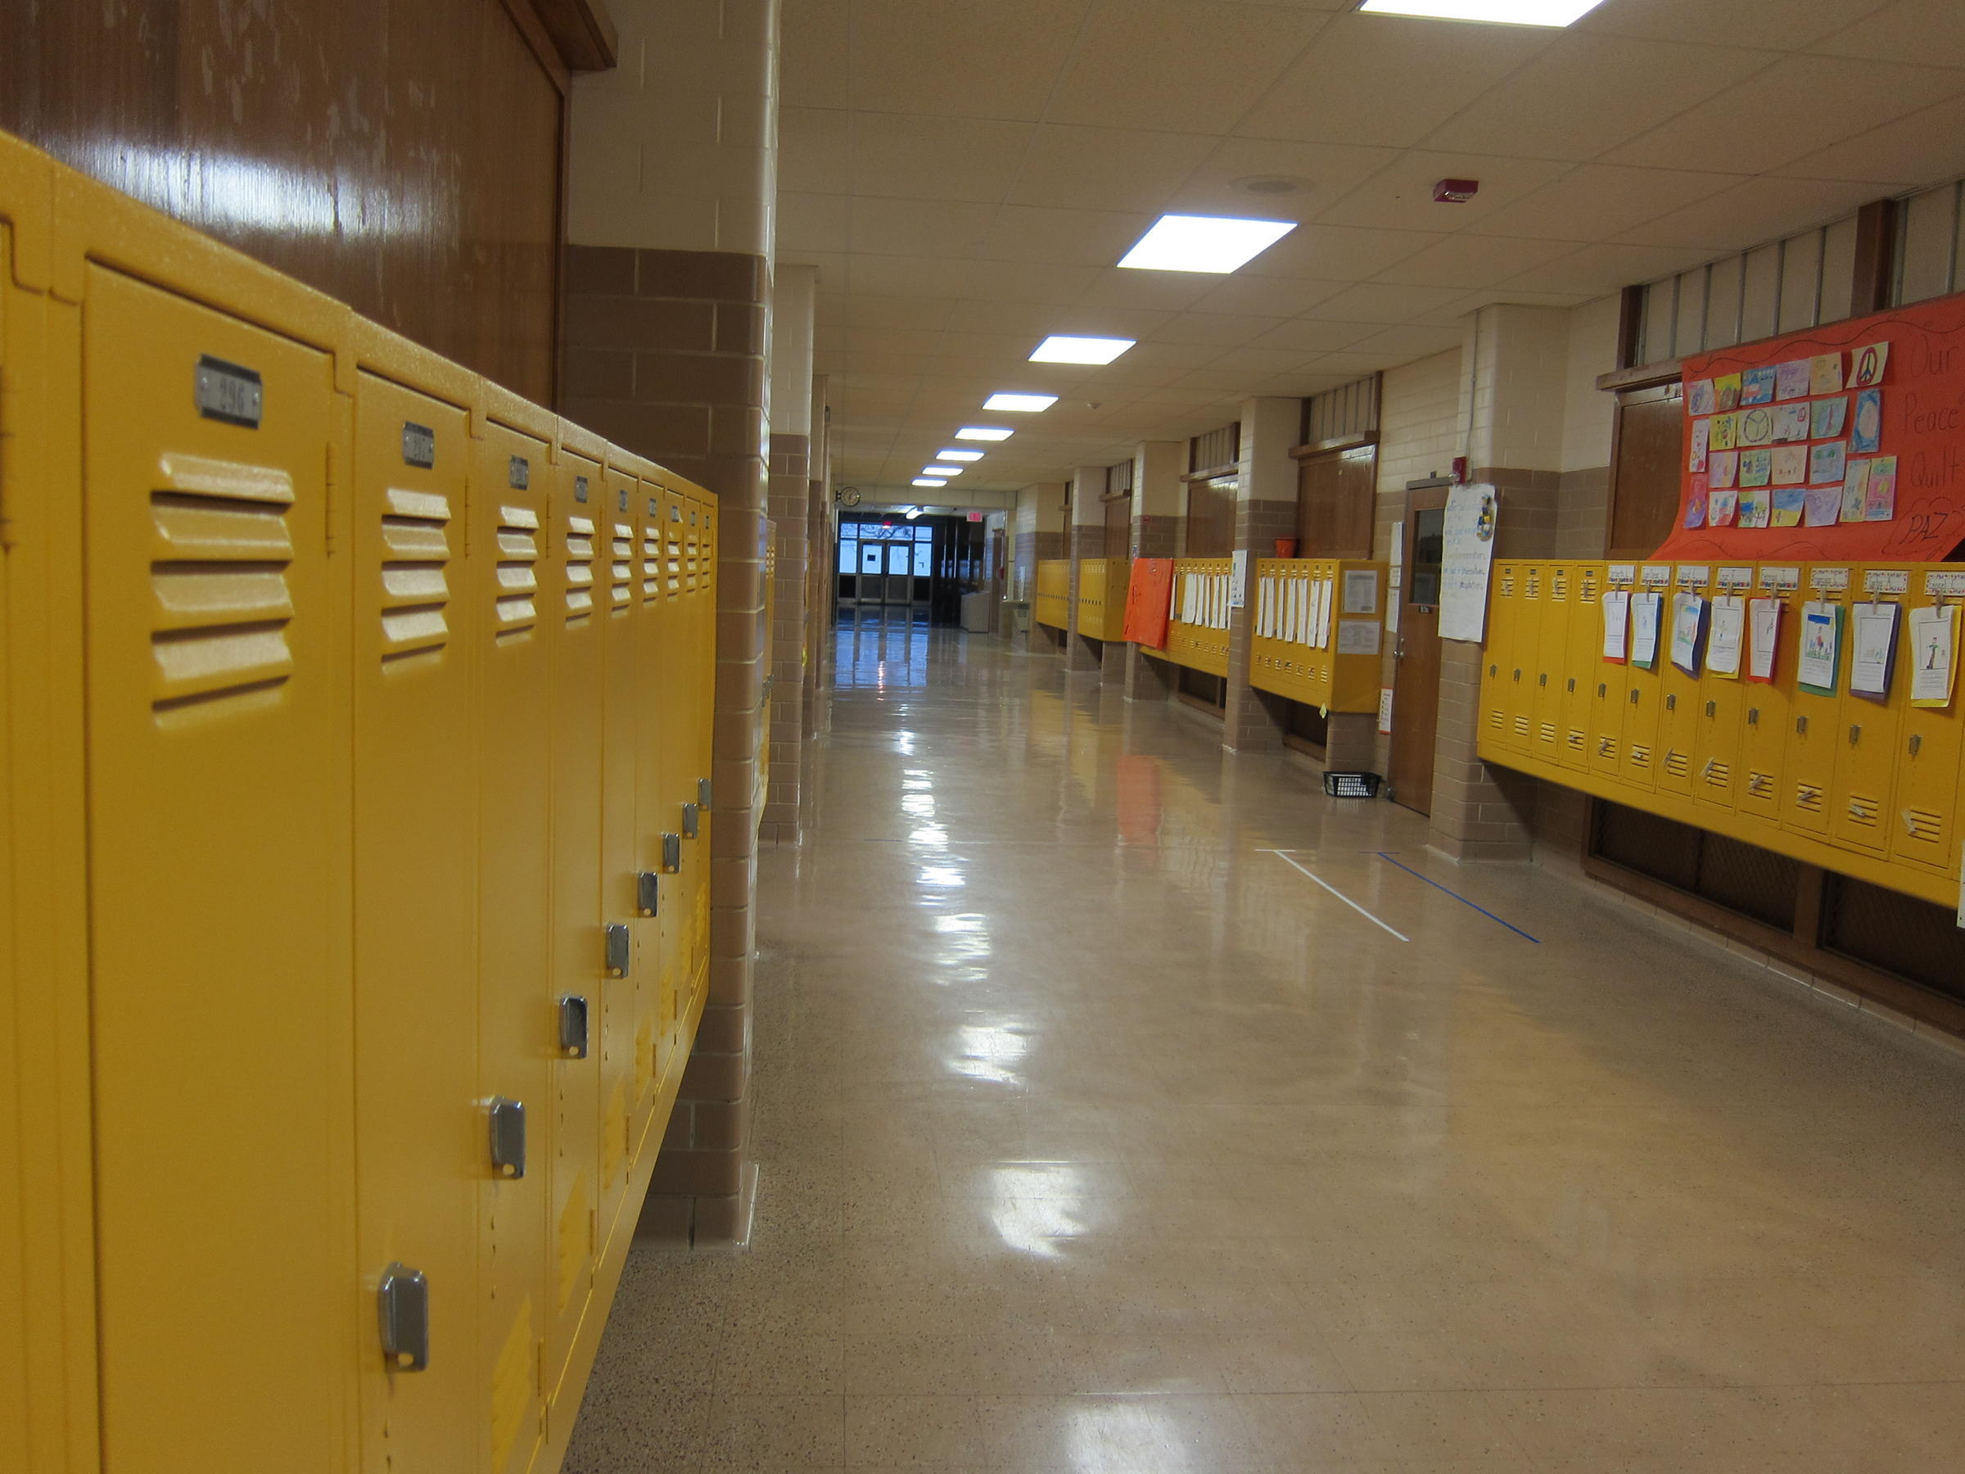
Alyssa’s Law
SB 70 Requires an extra layer of protection for Florida schools
All public schools – including charter schools - must have mobile panic alert systems by the start of the 2021-2022 school year
Enables all school staff to silently and easily contact law enforcement to respond to an on-campus threat or crisis
This Photo by Unknown Author is licensed under CC BY-SA-NC

Slide 3
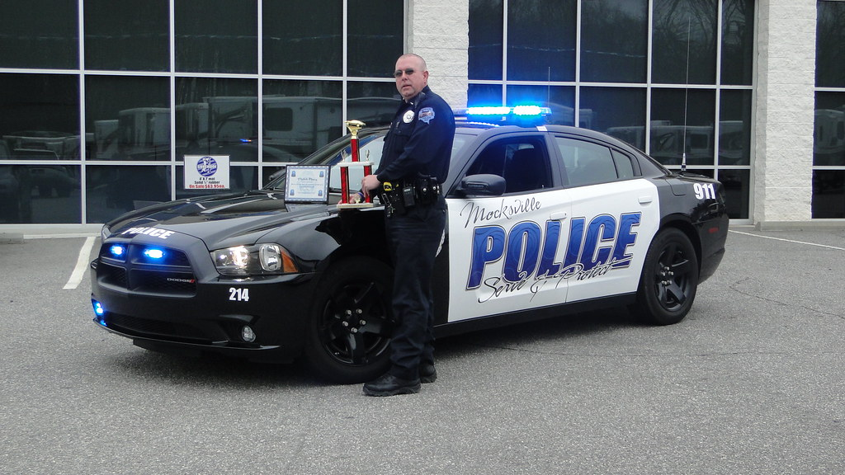
Alyssa’s Law
Mobile panic alert system must:
Ensure real-time coordination with first responders
Transmit 911 calls and mobile activations
Be in place by start of 2021-2022 school year

Slide 4
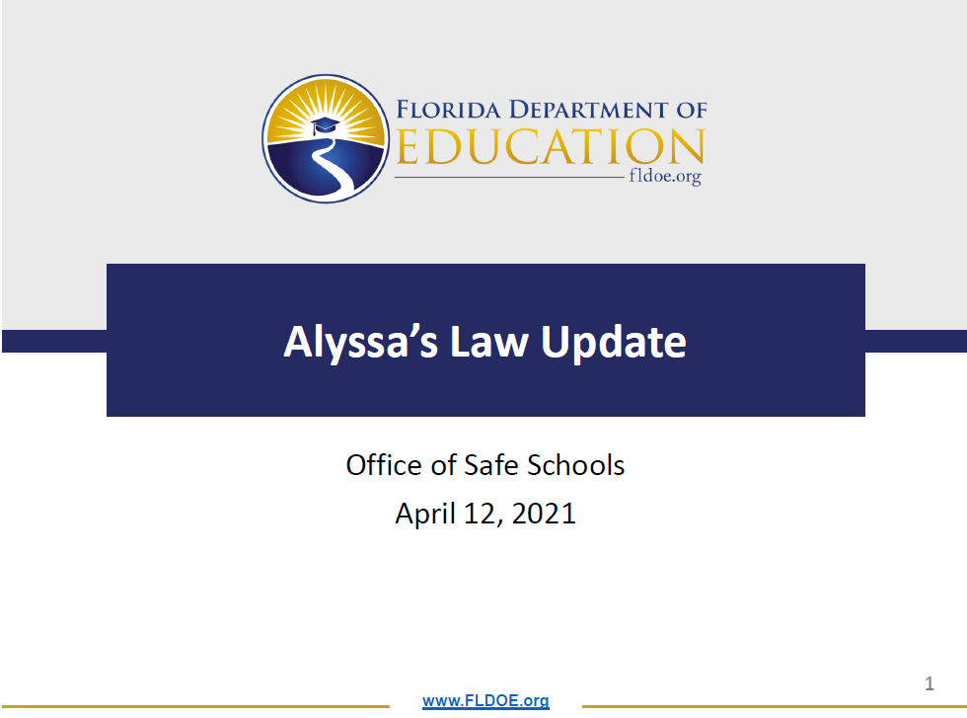
Alyssa’s Law
Specifications as to the scope of services, listed in the FDOE webinar:
https://attendee.gotowebinar.com/recording/6765833121164737037.

Slide 5

Alyssa’s Law Vendors
                10 Vendors selected by the FDOE
    Districts [or charter schools] choosing services from one of these vendors:
    FDOE will reimburse the vendor directly for the agreed upon services up to each district [or charter’s] allocation.
    Allocation is $2000 per school
911Cellular
Everbridge
AppArmor
Guard911
ARES
Intrado
AT&T
Motorola
CENTEGIX
Raptor

Slide 6

Alyssa’s Law
Districts
Identify vendor of choice
Attach contract (36 months)
Submits to Office of Safe Schools
911 attests to performance measures

Slide 7

Alyssa’s Law
How is this being implemented in your district?
On 4.19.2021, the Manatee CSO, along with District Safety folks:
Met with Charter School Administrators via Microsoft Teams to present the choice of District Vendor
Discussed expectations for charters: dates, timelines, key points
Shared Vendor Contact information with Charters to review products.

Slide 8



Alyssa’s Law
  Manatee
  Implementation
District request charters identify vendor by 5.11.2021
District meetings with 911 Chief ongoing
911 Needs to Know:
Vendor charters are choosing for coordination with Dispatch
Other Considerations:
Coordinating multiple vendors incoming to a single 911 center
Charters choose same vendor as district

Slide 9


Alyssa’s Law
Discussion Questions:
What concerns do you have about implementation of Alyssa’s Law?
How will you monitor compliance?
Are there any nuances that you are concerned about?
Office of Safe Schools will visit public school campuses to ensure fidelity

