Slide 1
CHARTER REVIEW TEAM TRAINING
Your role as Charter Review Team member and what to expect

Slide 2
Objectives
Review Charter Law and the application process
Know what the Florida Principles and Standards are and how they apply to the application review process
Understand your role and responsibilities as a review team member
Identify the key elements found in the charter application
Understand how to use the application evaluation rubric

Slide 3
Charter Law F.S. 1002.33 (6)(b)
A sponsor shall receive and review all applications for a charter school using the evaluation instrument developed by the Department of Education. A sponsor shall receive and consider charter school applications for charter schools to be opened at a time determined by the applicant.

Slide 4
Charter Law F.S. 1002.33 (6)(b)
3.a. A sponsor shall by a majority vote approve or deny an application no later than 90 calendar days after the application is received, unless the sponsor and the applicant mutually agree in writing to temporarily postpone the vote to a specific date, at which time the sponsor shall by a majority vote approve or deny the application.

Slide 5
Charter Application Process
Sponsor receives charter application proposals
The Sponsor shall give charter applicants 7 calendar days to make technical of non substantive corrections
Charter Review Team conducts a review of all charter application proposals
Charter Review Team meets to discuss charter application proposals
Charter applicants attend capacity interviews facilitated by the charter staff and possibly members of the Charter Review Team
Charter Review Team meets to finalize charter application discussions and vote on each application
Charter staff notifies charter applicant of the Charter Review Team’s recommendation
Charter staff delivers Charter Review Team’s recommendation of each charter application to the Superintendent at a work session
The district board members vote on each charter application proposal
If the charter application is denied, the Sponsor shall notify the applicant within 10 calendar days of the vote, containing reasons for the denial
Charter applicants may appeal no later than 30 calendar days after receipt of the denial letter to the State Board of Education
Allow charter applicants to present their program at a work session or workshop

Slide 7
Standard 2 – Application Process and Decision Making
A quality sponsor implements a comprehensive application process that includes clear application questions and guidance; follows fair, transparent procedures and rigorous criteria; and grants charters only to applicants who demonstrate strong capacity to establish and operate a quality charter school.

Slide 8
Standard 2 – Application Process and Decision Making
Standard 2(A) Proposal Information, Questions, and Guidance
Standard 2 (B) Fair, Transparent and Quality Focused Procedures
Standard 2 (C) Rigorous Approval Criteria
Standard 2 (D) Rigorous Decision Making

Slide 9
Standard 2 (D) Rigorous Decision Making
STANDARD CHECKLIST: Standard 2(D) – Rigorous Decision Making
Grant charters only to applicants that have demonstrated competence and capacity to succeed in all aspects of the school, consistent with the stated approval criteria,
Rigorously evaluate each application through a thorough review of the written proposal, a substantive interview with the applicant group, and other due diligence to examine the applicant’s experience and capacity, conducted by knowledgeable and competent evaluators,
When possible, engage for both written application reviews and applicant interviews, highly competent teams of internal and external evaluators with relevant educational, organizational (governance and management), financial, and legal expertise, as well as a thorough understanding of the essential principles of charter school autonomy and accountability,
Provide orientation or training to application evaluators (including interviewers) to ensure consistent evaluation standards and practices, observance of essential protocols, and fair treatment of applicants, and
Conduct application-review and decision-making processes that are free of conflicts of interest and require full disclosure of any potential or perceived conflicts.

Slide 10
Roles and Responsibilities of the Charter Review Team

Slide 11
Who reviews the Education Plan?
Application Sections | District Staff Responsibility
Section 1. Mission Guiding Principles and Purpose | Curriculum staff, Charter staff, Community Representative
Section 2. Target Population and Student Body | Charter staff, Community Representative
Section 3. Educational Program Design | Curriculum staff
Section 4. Curriculum and Instructional Design | Curriculum staff
Section 5. Student Performance | Assessment staff
Section 6. Exceptional Students | ESE staff
Section 7. English Language Learners | ESOL staff
Section 8. School Culture and Discipline | Discipline staff
Section 9. Supplemental Programming | Finance staff and district staff that relates to the specific supplemental programing identified in the application

Slide 12
Who reviews the Organizational Plan?
Application Sections | District Staff Responsibility
Section 10. Governance | Legal Counsel
Section 11. Management and Staffing | Human Resources
Section 12. Human Resources and Employment | Human Resources
Section 13. Professional Development
Section 14. Student Recruitment and Enrollment
Section 15. Parent and Community Involvement | Public or Community Relations staff
Section 10. Governance | Legal Counsel
Section 11. Management and Staffing | Human Resources
Section 12. Human Resources and Employment | Human Resources

Slide 13
Who reviews the Business Plan?
Application Sections | District Staff Responsibility
Section 16. Facilities | Facilities staff
Section 17. Transportation Service | Transportation staff
Section 18. Food Service | Food service/School nutrition staff
Section 19. School Safety and Security | School safety staff
Section 20. Budget | Finance staff
Section 21. Financial Management and Oversight | Finance staff
Section 22. Start-Up Plan | Charter office staff
Section 16. Facilities | Facilities staff
Section 17. Transportation Service | Transportation staff

Slide 14
Charter Review Team Responsibilities
Dedicate time to review charter proposals.
May be tasked to participate in charter contract renewals and 5-year program reviews.
Understand charter law as it pertains to charter applications and appeals.
Utilize and complete the Standard Model Charter School Application Evaluation Instrument when reviewing your designated section(s) of each charter application.
Participate in team meetings.
Submit recommendations to approve or deny on each charter application.

Slide 15
The Application
(You should review the application with your team members, so they know what elements are evaluated.)
LINK: Charter Application

Slide 16
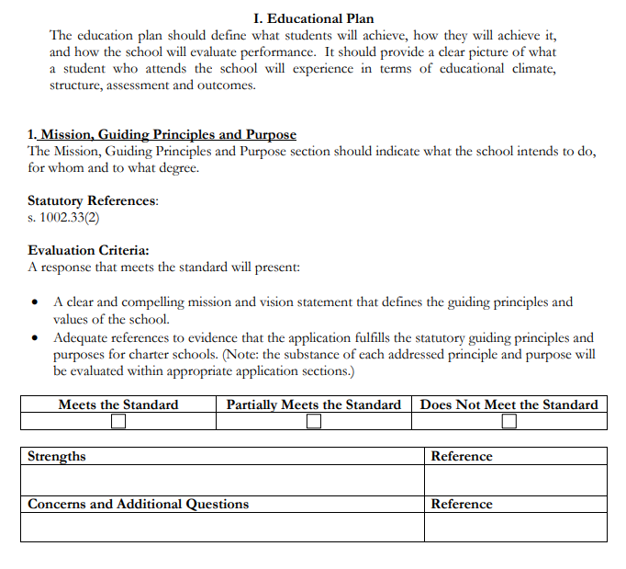
The Evaluation Rubric
(Walk your team members through the rubric. Make sure they understand what “Meets the Standard, Partially Meets the Standard, Does Not Meet the Standard” looks like. Use examples.)
LINK: Charter Application Evaluation Rubric

Slide 17
FAQS
Where do I find the digital versions of the new application?
Where do I submit my completed evaluations?
Who do I contact if I need assistance?
Are hard copies of the application available?

Slide 18
Schedule
Include all review team meeting dates
Capacity Interview dates
Meeting with Superintendent to make recommendations
Work Session/Shop Date
Board Vote date

Slide 19
Resources
Florida Statutes
Statutes & Constitution :View Statutes : Online Sunshine (state.fl.us)
Model Florida Charter School Application and Standard Model Charter School Evaluation Instrument
Statutes, Rules & Model Forms (fldoe.org)
Florida Principals & Standards for Quality Charter School Authorizing
Charter School Authorizers (fldoe.org)
Charter School Appeal
Charter School Appeal (fldoe.org)

Slide 20
Questions?

