Slide 1
FACSA: A Look Back
Friday, December 10, 2021

Slide 2
District Authorized Charters:
School Board Responsibilities
December 1, 2021
PRESENTERS
MELISSA BRADY, EXECUTIVE DIRECTOR, FACSA
KIA SWEENEY-SCOTT, PRESIDENT, FACSA
Who We Are Video
Notes:
Moderator will introduce us.

Slide 3
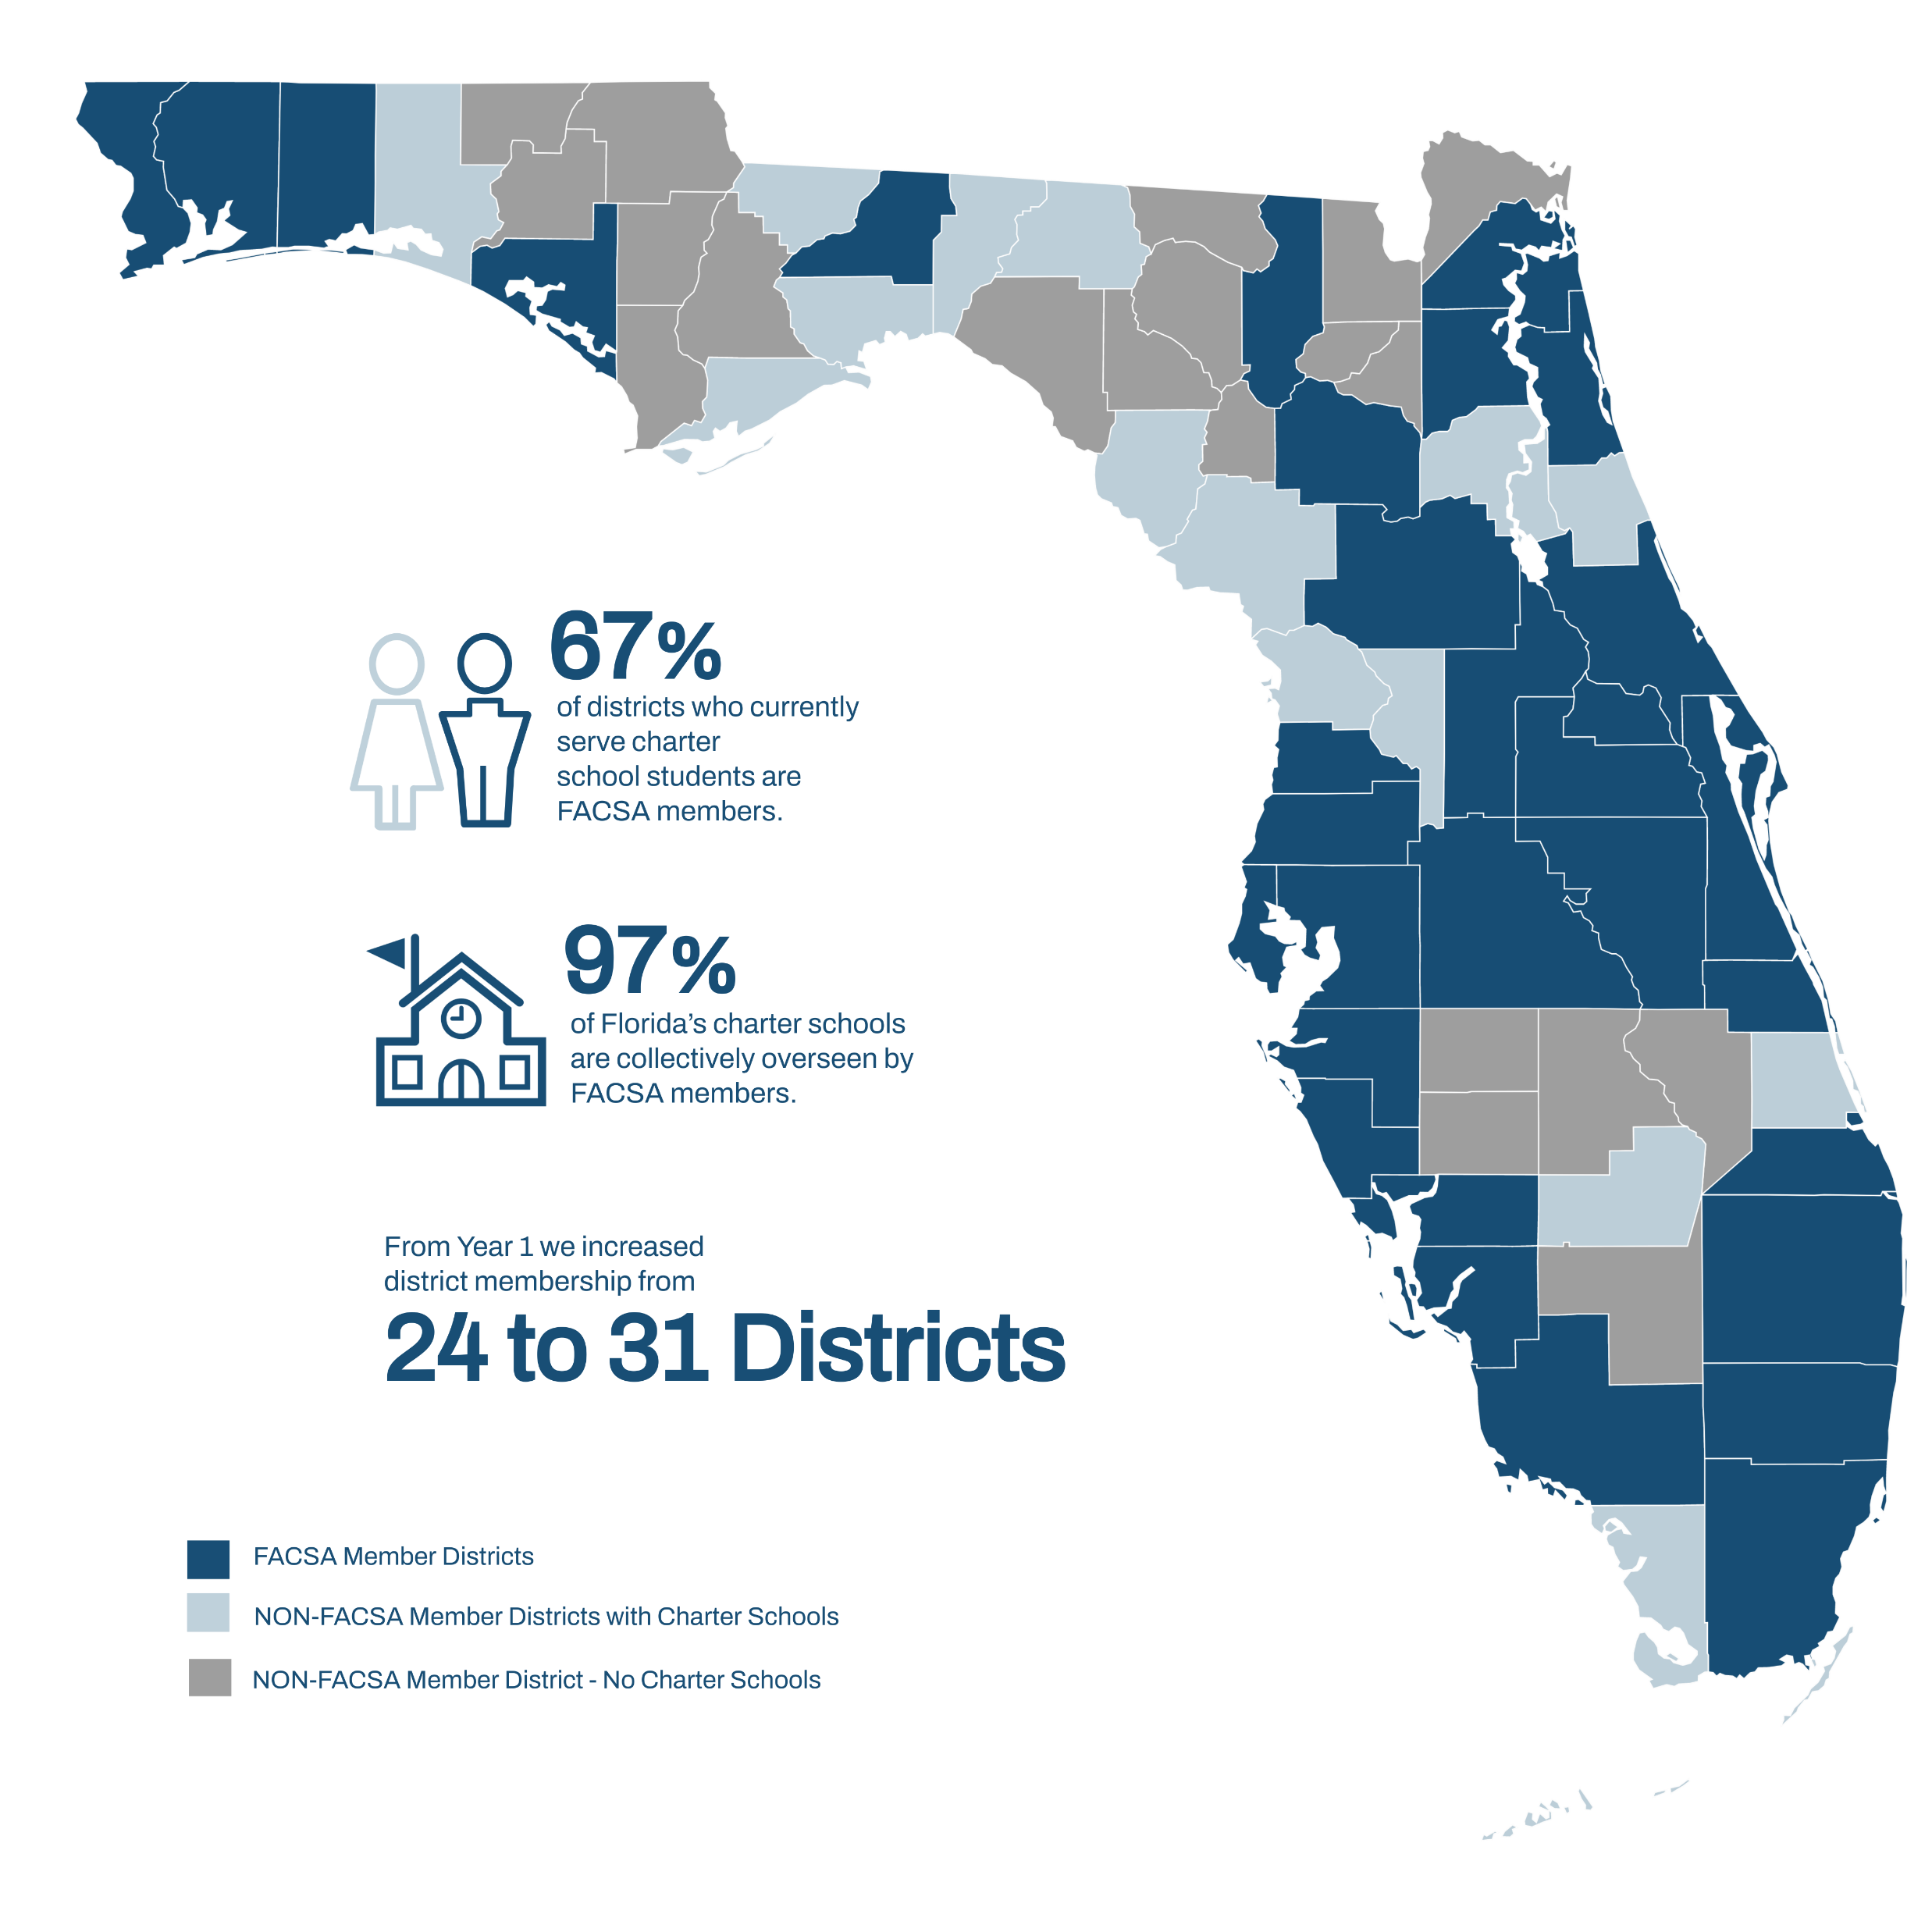
About our
members…

Slide 4
Accomplishments
Best Practices Materials and Professional Development
FACSA Charter Renewal Package
FACSA Bootcamp
And More
Provided External Reviewers to Districts
Authorizer Summit
Upcoming - Year Zero Guide
Provided more than 15 PD and Technical Assistance Documents
Annual Report Template and Rubric
Pre-Opening Checklist
Capacity Interview Toolkit for Florida Authorizers: Exceptional Student Education
Florida Charter School Contract Negotiations: District Considerations for Exceptional Students

Slide 5
Overall Summit Statistics
Statistics
63 Florida Authorizer Attendees
31 Florida districts represented
Attendees oversee 97% of Florida's Charter Schools
Attendees oversee 99% of Florida's Charter Students
19 Other Attendees (From National and Local Organizations)
FACSA Members Attendees
29 districts are members

Slide 6
Sessions at the Summit provided aligned training and support that were grounded in Florida Principles and Standards for Quality Charter School Authorizing.

Slide 7
Florida Authorizer Summit Post Survey
80%
99%
of attendees said they would attend the Summit in person next year.
scored the quality of sessions 8 or higher on a scale of 1 to 10.

Slide 8
Bootcamp Statistics
Attendance Data
# Attendees | 27
# New Authorizers (less than 2 years in role) | 17
% FACSA Members | 99%
% Florida Districts w/ Charters Represented | 35%
% of Charter Schools (Oversight) | 45%
% of Charter Students (Oversight) | 47%
Congratulations to our 6 graduates!
Betty Howard, Lake
Julie Summerlin, Lake
Michael Samala, Escambia
Randy Kelley, St. Johns
Sandra Tweedy, Volusia
Shameka Mitchell, Bay
“I would recommend this training to anyone who is new to authorizing charter schools."
"Authorizer Bootcamp was very informative.”
"Bootcamp was an amazing experience”
“Bootcamp was an amazing professional development.”

Slide 9
Accomplishments
Research: Access, Services, & Outcomes for Special Populations & Equity
Year 1 Research
Focused on students with disabilities who qualify for special education services under the Individuals with Disabilities Education Act (IDEA) and analyzed the proportion of students with disabilities enrolled in independent charter schools and students enrolled in charter schools managed by an education service provider (ESP).
Year 1 Findings
Research showed 353 of the state’s 658 charter schools (54%) were independently managed and 302 (46%) were managed by education service providers. While smaller in number, the ESP schools enrolled more students. The independent schools enrolled approximately 12.6% students with disabilities. In contrast, the ESP schools enrolled approximately 7.9% were students with disabilities.

Slide 10
Accomplishments
Research: Access, Services, & Outcomes for Special Populations & Equity
Year 2-3 Research
This study focused on barriers to enrollment. The research examined charter school recruitment, outreach, and admissions processes, as well as of special education procedures and services, to identify barriers to enrollment in charter schools for students with disabilities, including barriers that occur at the school- and the district-level.
Year 2-3 Findings
Research identified barriers as:
Limited parental knowledge about rights and services available for SWD at charter schools
Limited available services for SWD
Lack of certified staff

Slide 11
External Reviewers and Mentorships
External Reviewers
This year 4 districts engaged an external reviewer.
Clay
Collier
Hillsborough
Leon
Mentors
There is currently 1 formal mentor partnership.

Slide 12
Accomplishments
Conferences: FACSA Presentations / National Networking
Training in 2021
Charter Support Unit
Governing Board Training
New Applicant Training
Conferences in 2021
National Association of Charter School Authorizers
Florida Charter School Conference
Florida School Board Association and Florida Association of District School Superintendents Conference
National Network for District Authorizing (NN4DA) was launched in September 2021
The mission of NN4DA is to support state-level initiatives that assist school districts and similar entities in implementing authorizing practices that lead to quality and equitable outcomes for all students.
NN4DA will host quarterly webinars to include all state orgs and partners
First publication in The 74

Slide 13
Our Goals for 2022…
Convene the second annual Authorizer Summit in person.
Provide current and updated technical support and professional development for Florida authorizing district staff.
Roll out Authorizer Bootcamp 2022
Engage with the 16 districts who currently have charter schools but have not yet joined us.
Continue to partner with local and national organizations that support quality authorizing.
X
100%
X
100%
X
47

